Slide 1
Session 7 – Qualtrics Reproducibly Data Skills for Research Kellogg Research Support
August 17, 2023
Notes:
Welcome. We are so happy you’re here.
What you are about to hear next is about the closest you will get to a lecture in this workshop series. Most of the rest of this will be pretty interactive.
There will be discussions and you follow along with a demonstration, and maybe try to solve a few problems yourself.
But before we get into demonstrations of tools and how to apply them to your research work, I want to talk a bit about the reproducibility of that work you are about to start.
It is a very important topic, and I believe there are a few general principles that, if kept in mind, can help you quite a lot when you go to reproduce your work in the future.

Slide 2
Outline
Journal requirements
Transparency and Openness Promotion (TOP) and Open Science
How to practice open science
Automation for reproducibility with Qualtrics surveys
Demonstration

Slide 3
Why reproducibility?
Be kind to your future self
You will need it for publication!
Notes:
Today we're going to offer an overview of how to automate research with Qualtrics surveys for easy reproducibility.
Are you sold on why reproducibility is important yet? What are some good reasons to ensure reproducibility of your data?
Avoid the problem of trying to remember what you did!
Why would you use R instead of SPSS? -->Learn a programming language instead of SPSS, R code is more universal, free open-source software, and can apply to other analyses makes it easier for you in end
I'm going to work backwards and start with the reason you're all here: RESEARCH! So I will start with what journals need from you to get published.

Slide 4
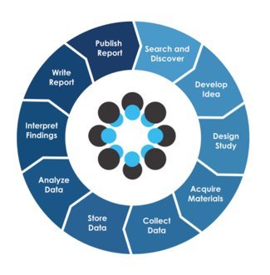
What do journals require for publication?
Open Science practices
Open Science Framework from Center for Open Science
Notes:
GINGER
Increasingly, journals require their authors to practice some form of open science.
What do you already know about open science?
Check out OSF site – you can review the video on your own and browse the site
article on implementation of OSP in mgmt https://www.tandfonline.com/doi/full/10.1080/1359432X.2023.2206571?scroll=top&needAccess=true&role=tab
--> Give a research topic and look through the available projects together
https://www.aje.com/arc/benefits-of-preprints-for-researchers/
Preprints achieve many of the goals of journal publishing, but within a much shorter time frame. The biggest benefits fall into 3 areas: credit, feedback, and visibility.
A preprint is a full draft research paper that is shared publicly before it has been peer reviewed. Most preprints are given a digital object identifier (DOI) so they can be cited in other research papers.
Can think of 4 stages of OS:
Preregistration
Project execution
Preprint
Publish

Slide 5
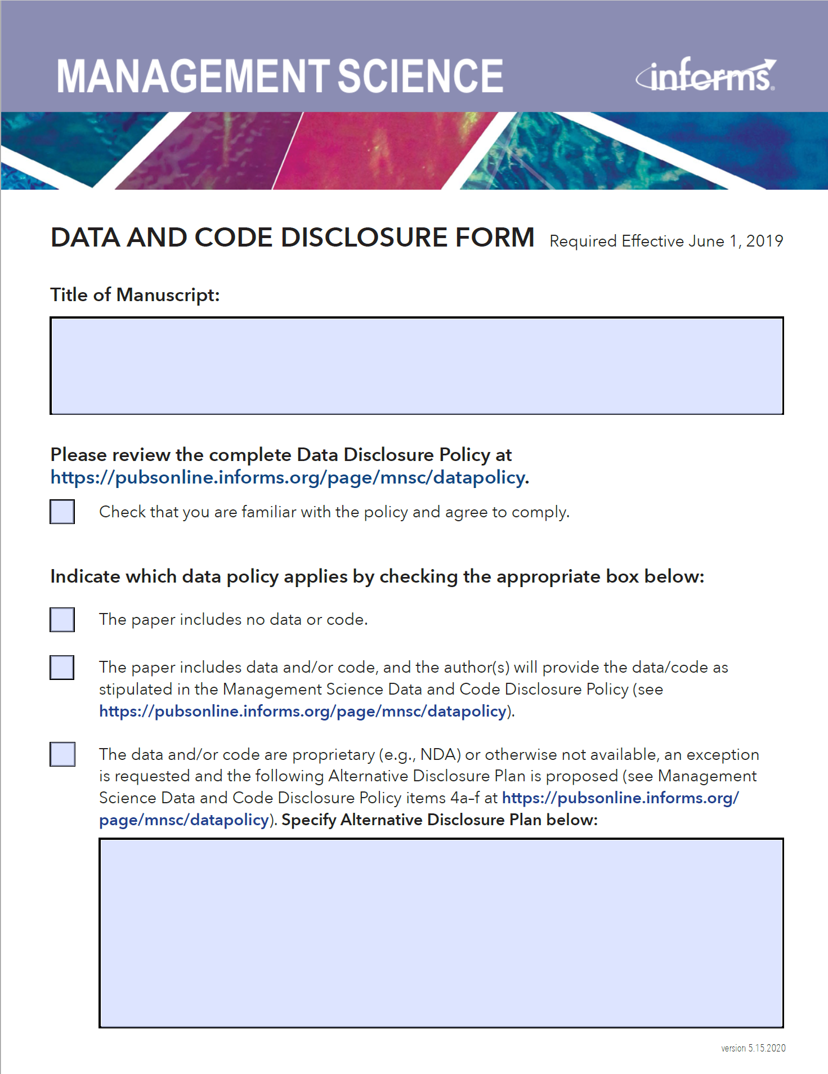
What do journals require for publication?
Changing landscape of academic publication requirements
SAGE Publications
Journal of Personality and Social Psychology (2021)
AMA Journals
Journal of Marketing (2023)
Notes:
GINGER
Journals are starting to implement OS requirements, we are in a time when the requirements are always changing and moving twd more OS
Expect skepticism in reaction to your work, think about how to anticipate this; ppl will try to recalculate what you did, try different inclusion data (investigate how different subsets of data affect the results. For example, they could analyze a dataset with different subsets of participants or exclude certain outliers to understand the impact on the findings)
--> you may have submitted last year, and now they have a new policy you must adhere to

Slide 6
Transparency and Openness Promotion (TOP)
TOP Guidelines
TOP Factor
AEA
Notes:
https://www.cos.io/initiatives/top-guidelines ; https://www.cos.io/about/news/new-measure-rates-quality-research-journals-policies-promote-transparency-and-reproducibility
"an alternative to journal impact factor (JIF) to evaluate qualities of journals. TOP Factor assesses journal policies for the degree to which they promote core scholarly norms of transparency and reproducibility. TOP Factor provides a first step toward evaluating journals based on their quality of process and implementation of scholarly values. This alternative to JIF may reduce the dysfunctional incentives for journals to publish exciting results whatever their credibility."
The hope is... "Journal policies can be evaluated based on the degree to which they comply with the TOP Guidelines. This TOP Factor is a metric that reports the steps that a journal is taking to implement open science practices, practices that are based on the core principles of the scientific community. It is an alternative way to assess journal qualities, and is an improvement over traditional metrics that measure mean citation rates. The TOP Factor is transparent (see underlying data and the evaluation rubric) and will be responsive to community feedback."
TOP Factor: click on the data transparency and the analysis code transparency and see that AEA is highly ranked.

Slide 7

What is Open Science?
Center for Open Science, transparency standards
Citation
Data transparency
Analytic methods (code) transparency
Research materials transparency
Design and analysis transparency
Preregistration of studies
Preregistration of analysis plans
Replication
Notes:
GINGER
“Open science” is a collection of practices that make the content and process of producing evidence and claims transparent and accessible to others.
Concepts: openness, transparency, rigor, reproducibility, replicability, and accumulation of knowledge
Often related aspects impacting the entire research lifecycle, including four major pillars:
Open research data
Open software code
Open access to papers
Open peer-review
Research transparency and accessibility are key to evaluating the credibility of both statistical evidence and scientific claims. Credibility rests in part on its reproducibility (evidence/data/code) and replicability (results/sci claims).

Slide 8
Why Open Science?
Principles of inclusion, fairness, equity, and sharing
Reduce inequities in access to knowledge
Accelerate scientific progress and discoveries
Increase rigor, accountability, and reproducibility
Notes:
Inspired from the replicability crisis (AKA replication or reproducibility crisis) that hit the sciences around 2010
Reduce inequities in access and knowledge
e.g Make it easier to access data and information without having to pay high fees for journal access
Accelerate sci prog and discoveries:
knowledge creation is more efficient via collab and strengthened through critique --> harness network effects (pragmatic school)
Societal engagement is necessary for societal impact, invite public to collab via citizen sci and make scholarship more understandable in lay terms (public school)
efficient research requires readily available platforms, tools and services for dissemination and collaboration (infrastructure school)
Increase rigor, accountability, and reproducibility
https://doi.org/10.7287/peerj.preprints.2689v1 Several studies have furthermore reported that scientific papers accompanied by publicly available data are on average cited more often [19,20], and are moreover characterized by fewer statistical errors and a greater degree of robustness [21].

Slide 9
How do I Practice Open Science?
Think ahead!
Reproducibility
Reduce collection of identifiable info
IRB language in sections:
Provisions to Protect Participant Privacy and Data Confidentiality
Long-term Data and Specimen Storage and Sharing
Use a data repository
Some journals require deposit in a specific repository
AEA
Notes:
GINGER
Data repository: some journals have their own requirements of a specific repo and other journals may provide a list of acceptable repositories
There are guides available to researchers on what to consider. I can send the ICPSR and UCL guides.
Reduce collection of identifiable information. When you post data, you need to remove identifiable information. To reduce data cleaning, think of creative ways to get the information you need without collecting identifiable information. The behavioral lab will help keep things anonymous, serving as a middle-person. We use Sona ID instead of names or emails and we can contact a raffle winner, for example so you do not have to collect contact information.
• IRB protocol (reminder that you should always go to the website when starting a new protocol b/c IRB updates their templates often):
Provisions to Protect Participant Privacy and Data Confidentiality
Where and how will you store data/specimens? How long will you store the data or specimens? What will happen to the data/specimens at the end of your study? (Note: Under NU policy, you must keep research data a minimum of 3 years after the completion of the study. However, there are circumstances when other time periods may apply. You must retain consent forms that contain HIPAA authorizations must be retained for at least 6 years after completion of the study.)
For detailed guidance on good research data security practices, please see NU IT's website at https://www.it.northwestern.edu/security/research.html.
If you will be collecting research data while outside the United States, please see NU IT's tips on data security when traveling: https://www.it.northwestern.edu/security/travel.html
Long-term Data and Specimen Storage and Sharing
If you plan to store data/specimens and share them long-term for future research, explain your plan for storing and sharing the data. If you plan to place your data in a data repository, explain which repository/database and why.
Explain whether you will include identifiers with the data/specimens when you share them.

Slide 10
How do I Practice Open Science?
Data Files
Syntax Files
Output Files
Codebook or Data Dictionary
Documentation
README File
Data Backup
Anonymized or De-Identified Data
Notes:
The key to reproducibility is clear documentation.
Data Files: These contain the raw data you collected or obtained for your study. You should save the original data files in a format that SPSS can read, such as .sav (SPSS data file), .csv (comma-separated values), or Excel format. This ensures that others can access and verify your data.
R - Save the original raw data files in a format that R can read, such as .csv, .txt, or .xlsx. This ensures that others can access and verify the data you used in your analysis.
Syntax Files: SPSS syntax files (.sps) contain the commands and instructions you used to perform data cleaning, transformation, and analysis. By saving your syntax files, you provide a clear record of the steps you took to process the data and generate results. This is crucial for replication.
Output Files: SPSS output files (.spv or .spo) contain the results of your analyses, including tables, charts, and statistical tests. Saving these files allows others to review your results and verify your findings. Include both tables and graphical representations.
Codebook or Data Dictionary: A codebook is a document that provides detailed information about the variables in your dataset, including their names, labels, scales, and any recoding or coding procedures you applied. This helps others understand your data and analysis choices.
Documentation: Create a separate document that explains the research design, methodology, data collection process, and any specific decisions you made during the analysis. This documentation can help other researchers understand your study and replicate your work.
README File: Include a README file that provides a brief overview of the project, describes the purpose of each file, and provides instructions on how to replicate your analysis. This is particularly useful if someone else needs to work with your files in the future.
Data Backup: Make sure to keep backup copies of all your files, either in cloud storage or on physical media. This ensures that your data and analysis are preserved in case of any unexpected issues or data loss.
Anonymized or De-Identified Data: If your data contains sensitive or private information, make sure to create and save a version of the dataset that has been properly anonymized or de-identified to protect participants' privacy.
By saving these files, you provide a comprehensive and transparent record of your research process, making it easier for others to understand, verify, and replicate your work. This is a fundamental practice in promoting transparency and scientific integrity in research.

Slide 11
Demonstration
Notes:
Discussion to get started
What platforms do you use for deployment?
What software do you use for statistical analysis? For data cleaning?
What platforms do you use to gather online survey data?
Tell me some things you normally have to do to your raw survey data before it is ready to analyze.

Slide 12
Recall Points of Emphasis
Automate whenever possible
Test liberally
Keep good, long-term records
Best to manipulate, analyze data with code!
Always preserve your original data!
Notes:
These are ideas that we emphasized in earlier sessions. The three pillars of doing work now that you will be able to reproduce more easily in the future.
<CLICK>
And we argue there are at least a

Slide 13
To Use The Demonstration Program (R)
KLC details:
https://www.kellogg.northwestern.edu/research-support/computing/kellogg-linux-cluster
You will need a Qualtrics account, prior survey activity.
Change program to search for your survey title.
Run a one-time step to add your Qualtrics credentials to .Renviron.
Found under Account Settings / Qualtrics IDs: API Token, Organization ID, Datacenter ID

Slide 14
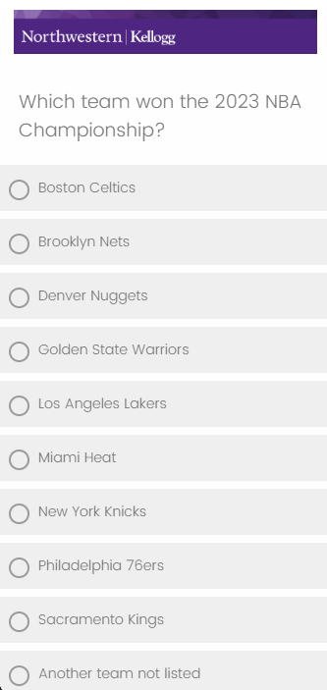
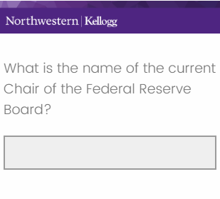
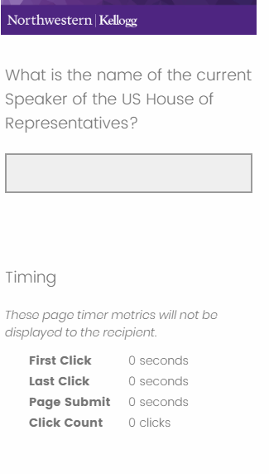
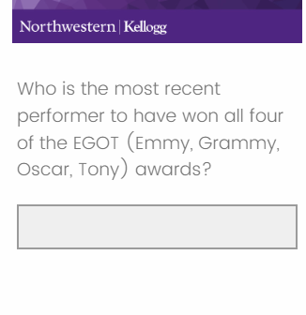
Survey Questions for Demo
Notes:
These are some of the questions that we asked in the survey that we will use in the demo. They essentially test knowledge of some current events or trivia-type questions. We figured while many people will immediately know the answers to some questions, most people would not be able to answer all of them without help.
Note: we measured response time for all these questions. Respondents were asked not to look up answers using outside sources, and the response times would give us some suggestion of whether they did this or not.

Slide 15
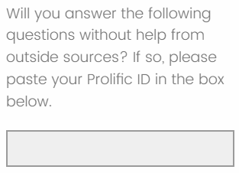
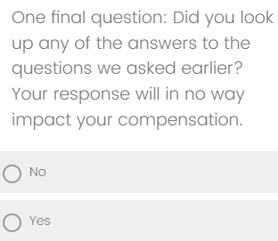
Survey Questions – No Outside Help
Notes:
In addition, we asked a few other questions to help us understand

Slide 16
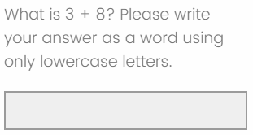
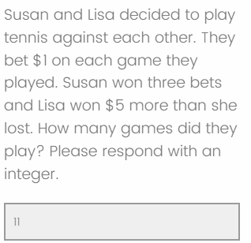
Attention and Comprehension Checks
Notes:
In addition, we asked a few other questions to help us understand

Slide 17
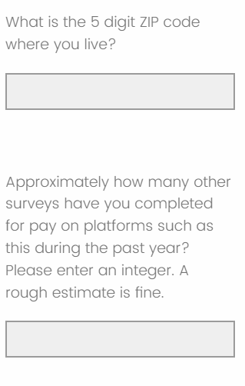
Respondent Attributes
Notes:
In addition, we asked a few other questions to help us understand

Slide 18
Go to KLC

Slide 19
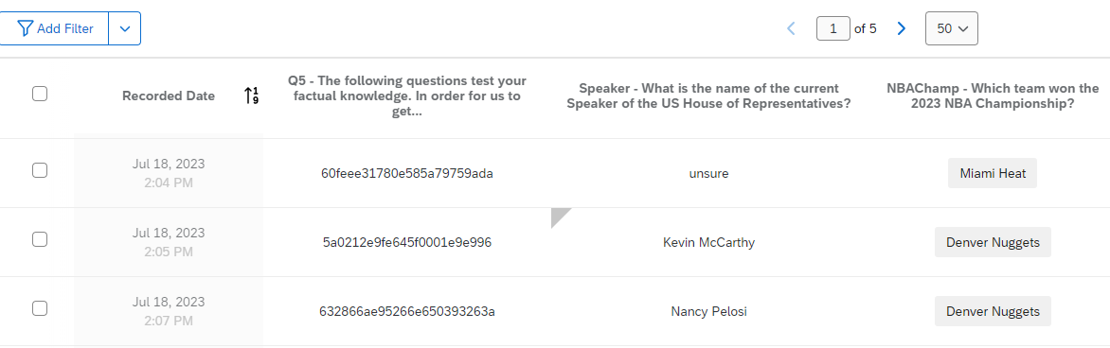


Beware: Response Editing Feature!
Notes:
Fortunately for you, this is a management, and we have some commonsense ideas for how to make collaborations – including with your future self – work better.
Some of those concepts that are most relevant to your scientific computing projects include:
Keeping records of what you do that will be easy to use,
Being very economical with your solutions. The #1 easiest way to fail at replicating your results is to present yourself with 2 different ways to solve the same problem.
And recognize that humans make mistakes. We forget things. We sometimes make poor decisions. So more generally, give your future self fewer opportunities to make mistakes.

